Slide 1
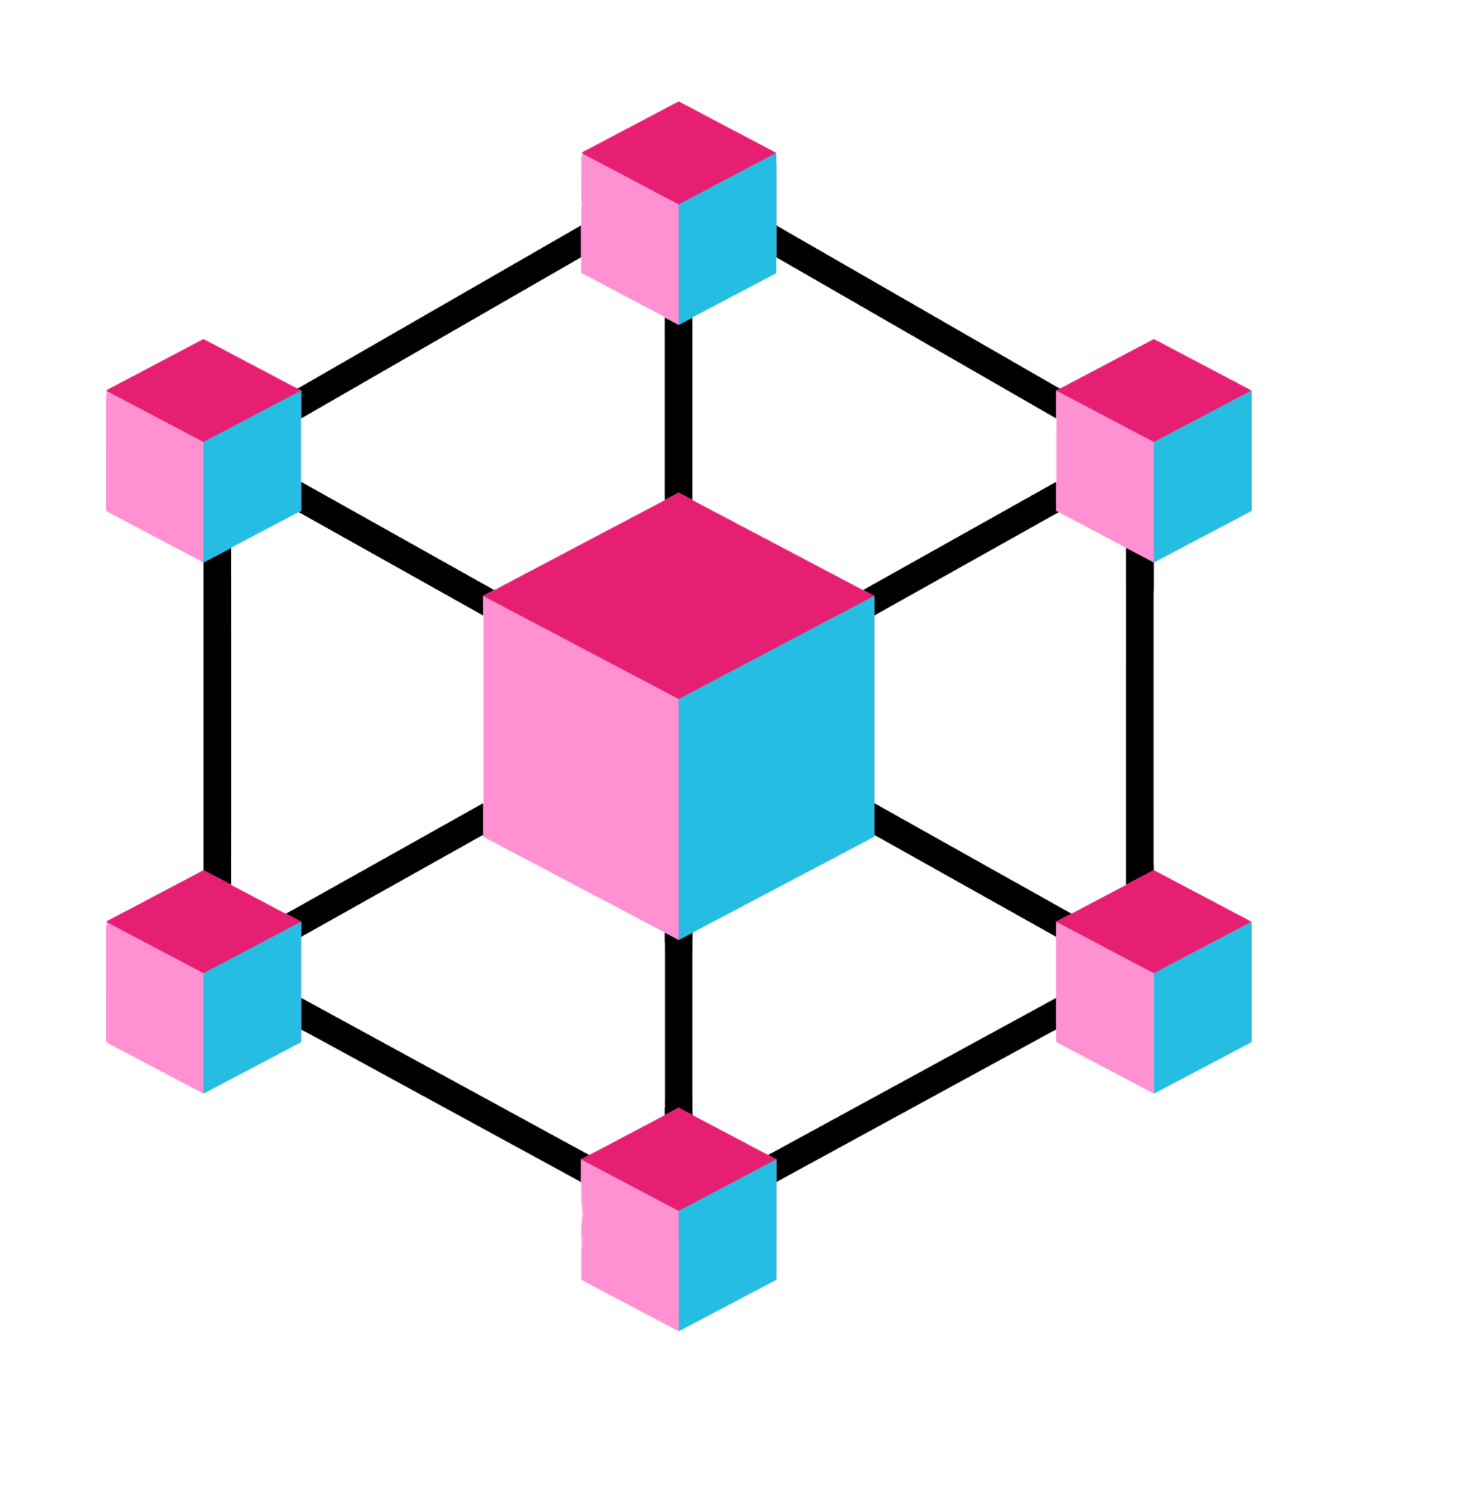


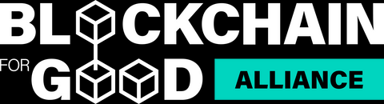

SDG BLOCKCHAIN ACCELERATOR
Blockchain Fundamentals with a Focus on
Cardano Smart Contracts
Technical Workshop

Slide 2

AGENDA
Blockchain Fundamentals
Why Cardano?
Cardano Smart Contracts
Aiken Introduction
Live Demo: Aiken Installation, Tools, APIs, SDKs
Exercises
Q&A

Slide 3

Blockchain Fundamentals
A blockchain is a distributed ledger maintained by a network of independent nodes.
Unlike traditional databases, where a single entity controls data input and storage, blockchains rely on consensus protocols to achieve data integrity and eliminate single points of failure.

Slide 4
Blockchain Fundamentals
Why Blockchain?
Decentralization:
No single entity controls the data.
Decisions and records are distributed across a network of nodes.
Reduces risk of censorship, manipulation, and single point of failure.
Transparency:
All transactions are recorded on a public or shared ledger.
Anyone can verify the history of a transaction.
Builds trust in systems like voting, supply chains, and public records.
Immutability:
Once data is added to the blockchain, it cannot be changed or deleted.
Protects against fraud and tampering.

Slide 5
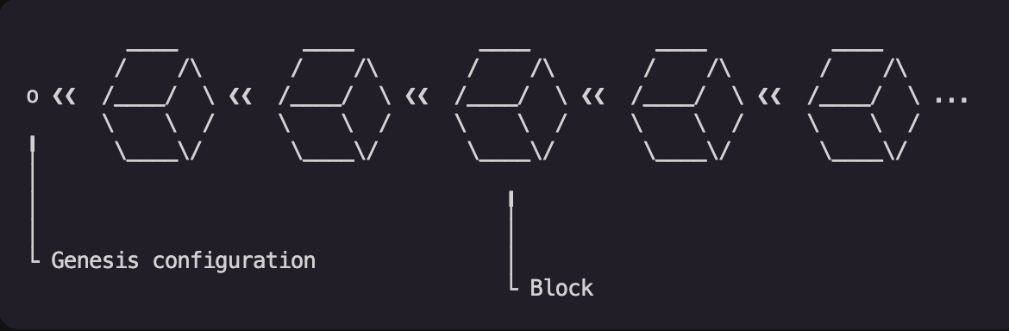
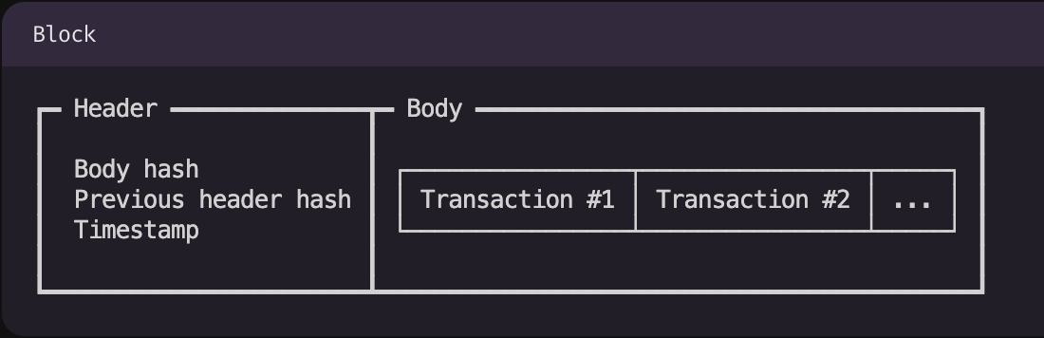
Blockchain Fundamentals
Blockchains are made of blocks.
And blocks are made of transactions.
Block has two parts: a header and a body
The header contains information about the blocks, such as who produced them and when they were made.
The body is nothing more than an ordered sequence of transactions

Slide 6
Blockchain Fundamentals
Public vs. Private Blockchains
Feature | Public Blockchain | Private Blockchain
Control | Open to everyone | Controlled by one entity
Transparency | Full public access | Private, permissioned access
Use Case | Crypto, DeFi, NFTs | Business, internal operations
Examples | Bitcoin, Ethereum, Cardano | Hyperledger, Corda, Quorum

Slide 7

Blockchain Fundamentals
In SDG contexts, the benefits include:
Decentralized governance: Multiple stakeholders can share control of disbursement contracts
Auditable processes: Anyone can verify that aid was disbursed as promised
Immutable records: Farmers can’t have their subsidy logs altered by corrupt intermediaries

Slide 8
Blockchain Fundamentals
Blockchain supports SDG efforts by addressing common gaps:
SDG Challenge | Blockchain Enabler
No identity → no service access | Decentralized ID + Verifiable Credential
Funds disappear in bureaucracy | Smart contract-based aid disbursement
No proof of ecosystem work | GPS + sensor metadata + immutable logs
No access to financial markets | Tokenized credit, P2P lending

Slide 9

Why Cardano?
Cardano was designed with research-first principles, focusing on scalability, sustainability, and formal verification.
It’s built to support real-world use cases like identity, finance, and governance - aligned closely with SDGs.

Slide 10
Why Cardano?
Three key innovations:
Proof-of-Stake (Ouroboros) | eUTxO Model | Native Assets
Cardano’s PoS consensus is scientifically proven secure. It balances security, decentralization, and energy efficiency. Introduced staking + delegation, enabling wide participation. | Builds on Bitcoin’s UTXO model, but supports smart contracts. Offers predictable execution, lower risk of runtime failure.. Gives developers more control and security than Ethereum's account-based model. | Cardano lets users mint and manage custom tokens natively — without smart contracts. This reduces cost, complexity, and potential bugs. Ideal for NFTs, stablecoins, and real-world asset tokenization.

Slide 11
Why Cardano?
Factor | Cardano | Ethereum
Philosophy | Research-first, slow but secure (backed by mathematical proofs and academic papers) | Build-fast, break-fix later (innovates quickly but is more trial-and-error)
Smart Contract Model | eUTxO (more deterministic) | Account-based (more flexible but less deterministic)
Security | Emphasis on formal methods | Less emphasis, more runtime risks
Transaction Costs | Lower | Higher, especially during congestion
Conclusion: Cardano is more secure and cheaper than Ethereum.

Slide 12
Cardano Smart Contracts
A smart contract consists of:
Datum – Data attached to the output, which provides contextual information needed for validation (e.g., a beneficiary’s wallet address or a hashed credential).
Redeemer – Data provided by the transaction attempting to consume (spend) the output, typically indicating the intent or action.
Validator – A script that checks whether the transaction is valid by evaluating the redeemer and datum along with other context.

Slide 13

Cardano Smart Contracts
Guessing Game:

Slide 14
Cardano Smart Contracts
On-chain vs Off-chain Code
Cardano smart contracts are split into two parts:
Type | Description | Tools/Examples
On-chain | Runs on the blockchain (validators). Pure, functional, and deterministic. | Plutus scripts, Aiken validators
Off-chain | Interacts with users, constructs and submits transactions | Lucid Evolution, MeshJS
Role in dApp architecture:
On-chain code enforces logic (e.g., who can spend a UTxO)
Off-chain code handles wallets, building transactions, querying state

Slide 15
Aiken Introduction
Aiken is a new, modern smart contract language for the Cardano blockchain, designed to be:
Fast to write
Easy to read
Safe to use
Efficient to execute on-chain
It compiles directly to Plutus Core (the low-level language Cardano nodes understand), but it uses a clean, developer-friendly syntax inspired by languages like Rust, Elm, and Haskell — without the complexity of Haskell itself.

Slide 16

Aiken Introduction
Installation
Language Tour
Primitive Types
Variables & Constants
Functions
Custom Types
Control Flow
Validators
Modules
Tests
Examples
https://aiken-lang.org/

Slide 17
Live Demo: Aiken Installation,
Tools, APIs, SDKs

Slide 18
Exercises
1. SDG Challenge Mapping
Task: Pick one SDG challenge (e.g., land title fraud, school attendance verification, farmer subsidy leakage)
Deliverable: Fill this table
SDG Problem | Blockchain Tool | Rationale
e.g. Land fraud in rural Kenya | Native token NFT + VC | Verifiable proof of land title on-chain
e.g. Training not recognized | Verifiable Credential | Proof of program completion stored in wallet

Slide 19
Exercises
2. Cardano Explorer Task
Task: Visit cardanoscan.io and paste a token policy ID
Reflect:
Who minted it?
What metadata is attached?
What is the transaction size?

Slide 20
Exercises
3. Technical Concept Comparison
Task: Write a 1-paragraph comparison of Ethereum vs. Cardano transaction models
Resources:
Cardano Docs - eUTxO: https://docs.cardano.org/about-cardano/learn/eutxo-explainer
Aiken eUTxO Crash Course:
https://aiken-lang.org/fundamentals/eutxo

Slide 21
Exercises
4. Guessing Game

Slide 22
Thank You & Let’s Build the Future Together
Q&A
SDG BLOCKCHAIN ACCELERATOR

